Slide 1

FPT University
Android programMing
Lesson 18
Version 1.0

Slide 2
Agenda
Implementing Video Playback on Android using the VideoView and MediaController Classes
Video Recording and Image Capture on Android using Camera Intents

Slide 3
Video Playback
One of the primary uses for smartphones and tablets is to enable the user to access and consume content especially video
The Android SDK includes two classes that make the implementation of video playback on Android devices
VideoView
MediaController

Slide 4
Video Playback
Introducing the Android VideoView Class VideoView class provides a surface onto which a video may be played. Android currently supports the following video formats:
· H.263 · H.264 AVC · H.265 HEVC · MPEG-4 SP · VP8 · VP9

Slide 5
Video Playback
The VideoView class has a wide range of methods that may be called in order to manage the playback of video
· setVideoPath(String path)
· setVideoUri(Uri uri)
· stopPlayback()
· pause() · isPlaying() · setOnPreparedListener(MediaPlayer.OnPreparedListener) · setOnErrorListener(MediaPlayer.OnErrorListener
· setOnCompletionListener(MediaPlayer.OnCompletionListener) · getDuration() · getCurrentPosition()
· setMediaController(MediaController)

Slide 6
Video Playback
Introducing the Android MediaController Class If a video is simply played using the VideoView class, the user will not be given any control over the playback, which will run until the end of the video is reached. The MediaController will then provide a set of controls allowing the user to manage the playback (such as pausing and seeking backwards/forwards in the video timeline)

Slide 7
Video Playback
Some of the key methods of this class are as follows: · setAnchorView(View view) · show() · show(int timeout) · hide() · isShowing()
Notes:
· setAnchorView(View view) – Designates the view to which the controller is to be anchored. This controls the location of the controls on the screen. · show() – Displays the controls. · show(int timeout) – Controls are displayed for the designated duration (in milliseconds). · hide() – Hides the controller from the user. · isShowing() – Returns a Boolean value indicating whether the controls are currently visible to the user

Slide 8
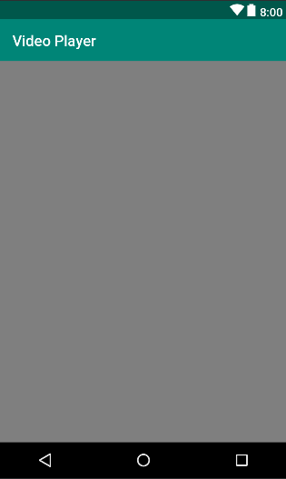
Video Playback
Creating the Video Playback Example

Slide 9
Video Playback
Configuring the VideoView
videoView = (VideoView) findViewById(R.id.videoView); String filepath = Environment.
getExternalStorageDirectory().toString() +
"/Download/music test.MP4"; videoView.setVideoPath(filepath); videoView.start();

Slide 10
Video Playback
Adding Internet Permission
<uses-permission android:name="android.permission.WRITE_EXTERNAL_STORAGE"/> <uses-permission android:name="android.permission.READ_EXTERNAL_STORAGE"/>

Slide 11
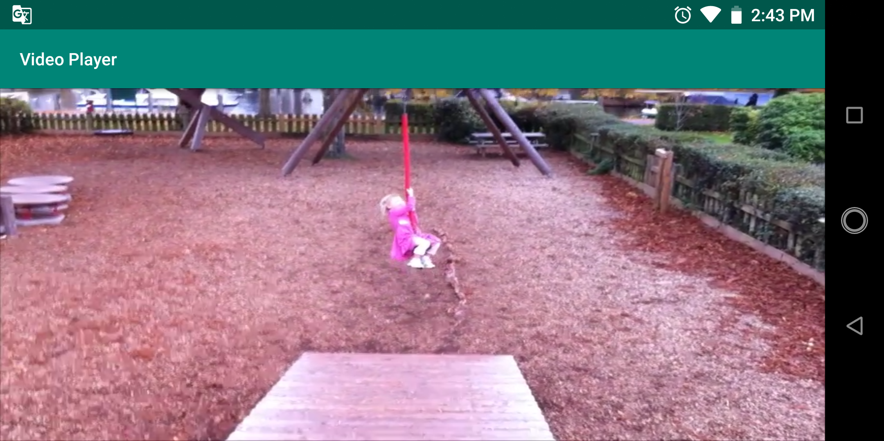
Video Playback
First test application

Slide 12
Video Playback
Adding the MediaController to the Video View
MediaController mediaController = new MediaController(this); mediaController.setAnchorView(videoView); videoView.setMediaController(mediaController); videoView.start();

Slide 13
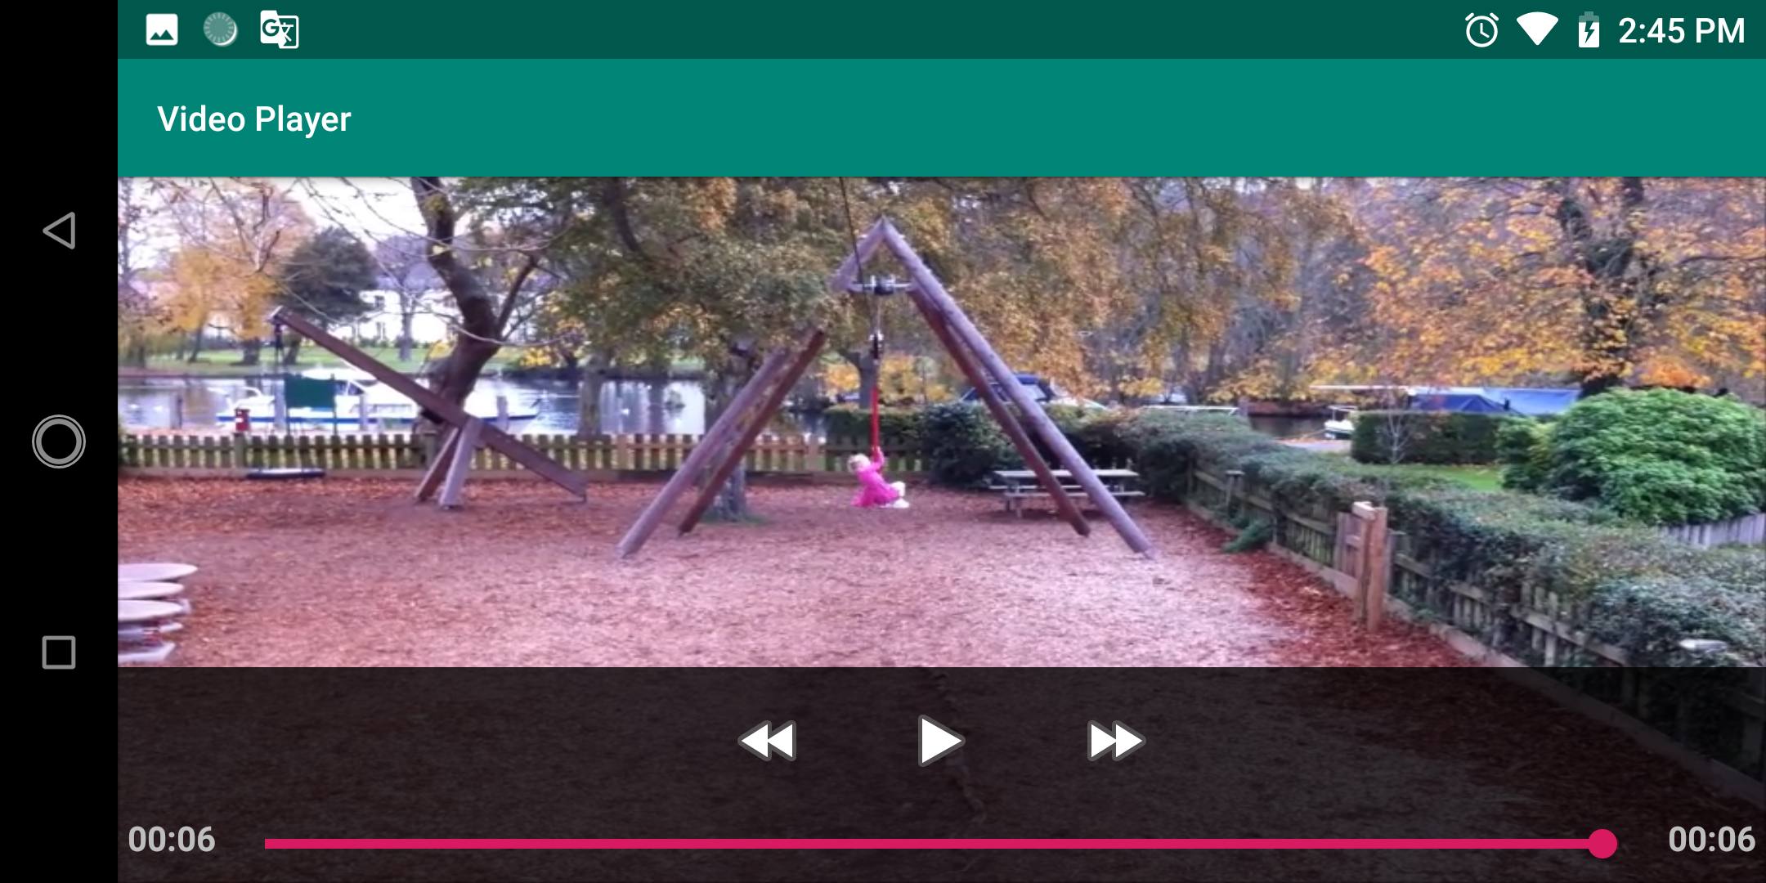
Video Playback
Testing applicaton

Slide 14
Video Playback
Let’s code the open local video file for yourself !

Slide 15
Video Playback
public void playOnClick(View view) { Intent intent = new Intent(Intent.ACTION_OPEN_DOCUMENT); intent.addCategory(Intent.CATEGORY_OPENABLE); intent.setType("video/*"); startActivityForResult(intent, PLAY_REQUEST_CODE); }
@Override protected void onActivityResult(int requestCode, int resultCode, Intent data) { Uri uri = data.getData(); if(resultCode == RESULT_OK){ if(requestCode == PLAY_REQUEST_CODE){ videoView.setVideoURI(uri); videoView.start(); } } }

Slide 16
Video Recording and Image Capture
Many Android devices are equipped with at least one camera. There are a number of ways to allow the user to record video from within an Android application via these built-in cameras, but by far the easiest approach is to make use of a camera intent included with the Android operating system. This allows an application to invoke the standard Android video recording interface. When the user has finished recording, the intent will return to the application, passing through a reference to the media file containing the recorded video.

Slide 17
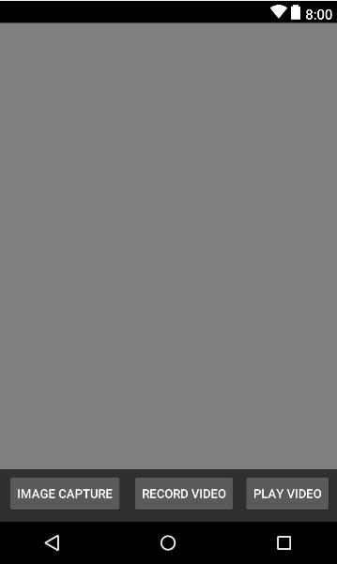
Video Recording and Image Capture
Create example project

Slide 18
Video Recording and Image Capture
Checking for Camera Support
public boolean hasCamera(){ return getPackageManager().hasSystemFeature(PackageManager .FEATURE_CAMERA_ANY); }

Slide 19
Video Recording and Image Capture
Disable buttons if has no camera
protected void onCreate(Bundle savedInstanceState) { super.onCreate(savedInstanceState); setContentView(R.layout.activity_camera_recording); Button recordButton = (Button) findViewById(R.id.buttonVideoCapture); Button catureImageButton = (Button) findViewById(R.id.buttonVideoCapture); if (!hasCamera()) { recordButton.setEnabled(false); catureImageButton.setEnabled(false); } }

Slide 20
Video Recording and Image Capture
Calling the Video Capture Intent
public void videoOnClick(View view) { Intent intent = new Intent(MediaStore.ACTION_VIDEO_CAPTURE); startActivityForResult(intent, VIDEO_REQUEST_CODE); }

Slide 21
Video Recording and Image Capture
Calling the Image Capture Intent
public void imageOnClick(View view) { Intent intent = new Intent(MediaStore.ACTION_IMAGE_CAPTURE); startActivityForResult(intent, IMAGE_REQUEST_CODE); }

Slide 22
Video Recording and Image Capture
Save image method
public void savePicture(Bitmap imageBitmap) { File root = Environment.getExternalStorageDirectory(); String timeStamp = new SimpleDateFormat("yyyyMMdd_HHmmss").format(new Date()); String imageFileName = "IMG_" + timeStamp; File cachePath = new File(root.getAbsolutePath() + "/DCIM/Camera/" + imageFileName +".jpeg"); try { cachePath.createNewFile(); FileOutputStream ostream = new FileOutputStream(cachePath); imageBitmap.compress(Bitmap.CompressFormat.JPEG, 100, ostream); ostream.close(); } catch (Exception e) { e.printStackTrace(); } }

Slide 23
Video Recording and Image Capture
Handling onActivityResult()
@Override protected void onActivityResult(int requestCode, int resultCode, Intent data) { Uri uri = data.getData(); if(resultCode == RESULT_OK){ if(requestCode == VIDEO_REQUEST_CODE){ Toast.makeText(this, "Video saved to: " + uri, Toast.LENGTH_LONG).show(); } if(requestCode == PLAY_REQUEST_CODE){ videoView.setVideoURI(uri); videoView.start(); } if(requestCode == IMAGE_REQUEST_CODE){ Bundle extras = data.getExtras(); Bitmap imageBitmap = (Bitmap) extras.get("data"); //imageView.setImageBitmap(imageBitmap); savePicture(imageBitmap); } } }

Slide 24
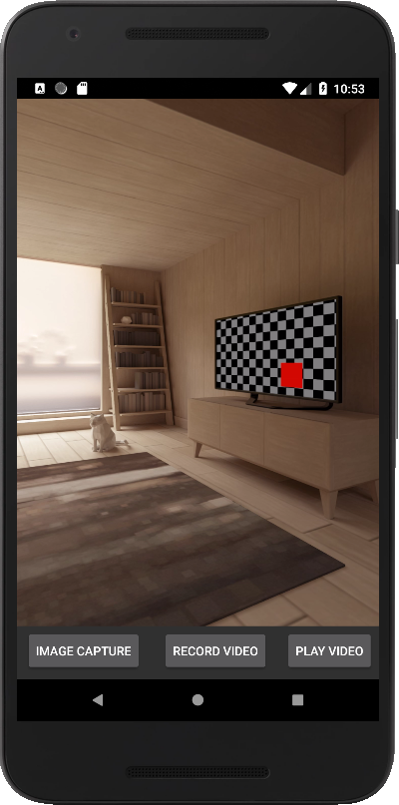
Video Recording and Image Capture
Testing application
Notes:
android:configChanges="orientation|screenSize">
Let’s student code for the save image to local storage

Slide 25

End of Lesson 18

Slide 26
Thank you!

